Slide 1
Verification
R Program
User Manual

Slide 2
PACK
CONT
VERIFY
SUM
Verification Brief Steps
04
03
02
SUM
01
VERIFY
Summary Data
CONT
Use verify function to summarize such forecasts
PACK
Input Data for Contingency Table
Install verification
Package
Notes:
© Copyright PresentationGo.com – The free PowerPoint template library

Slide 3
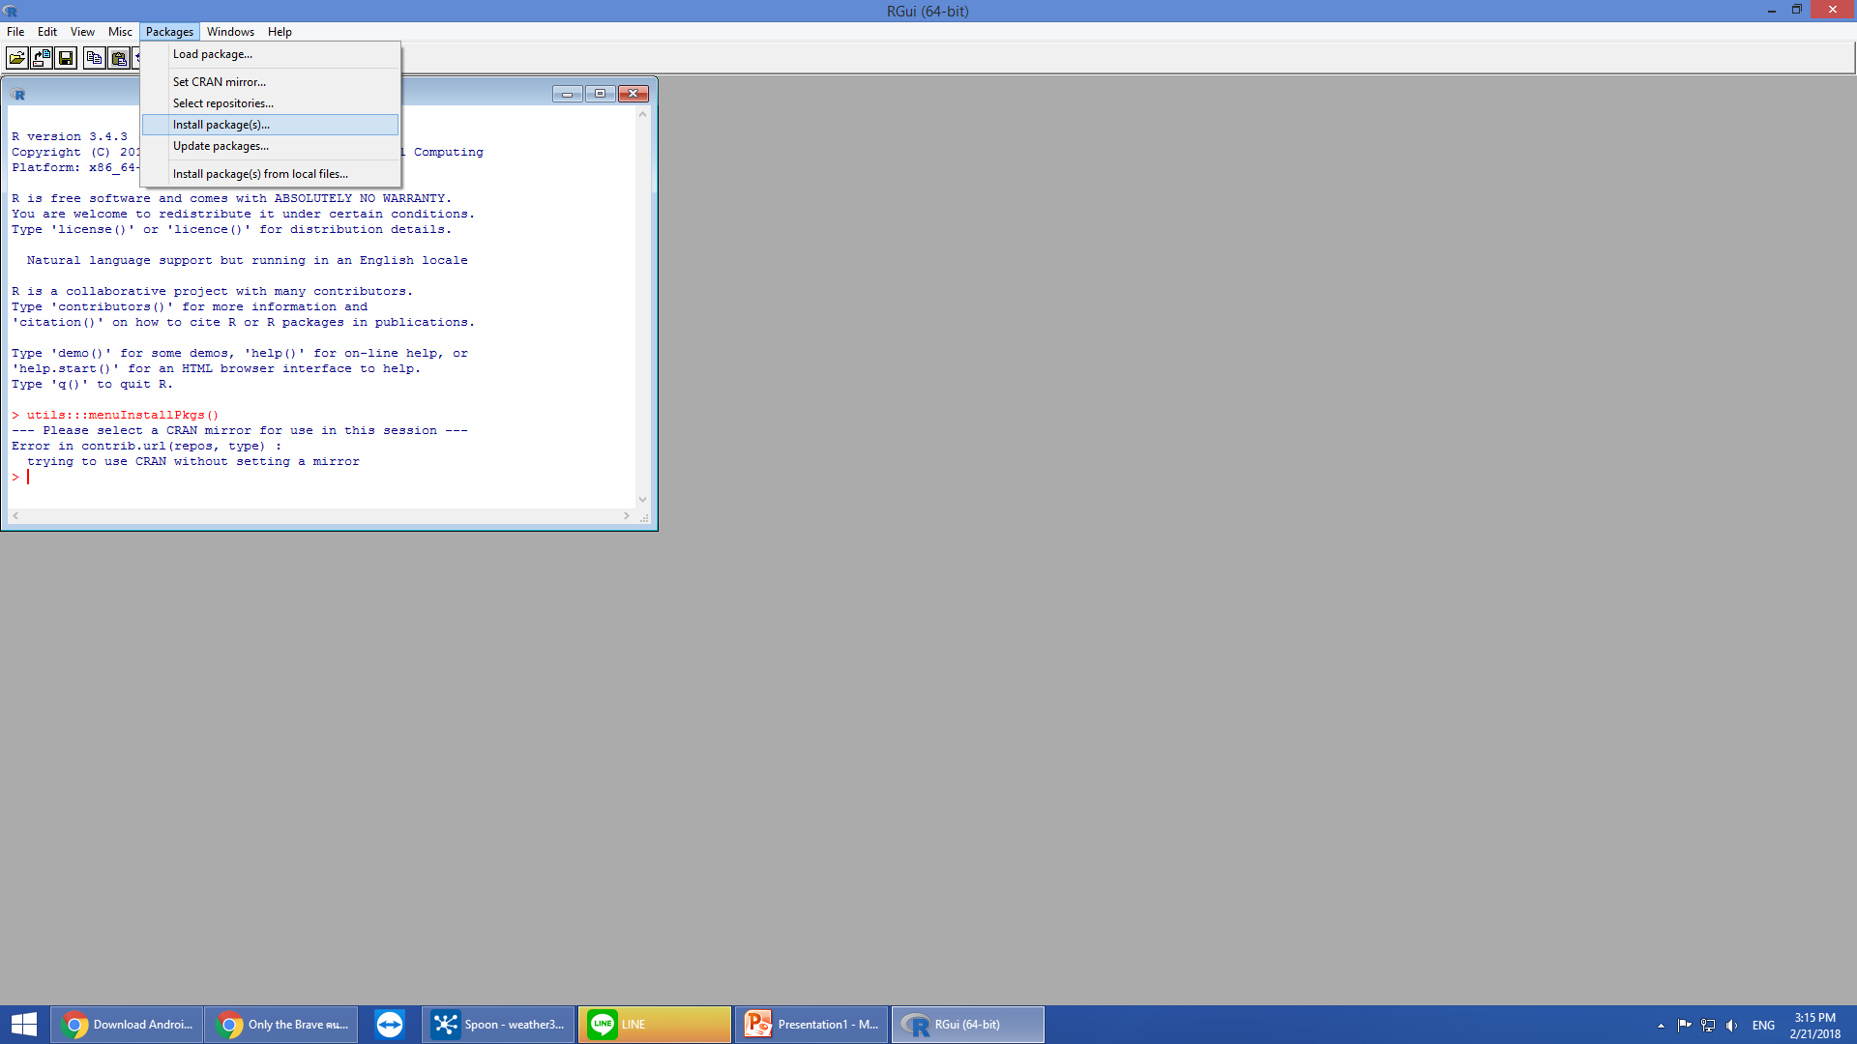
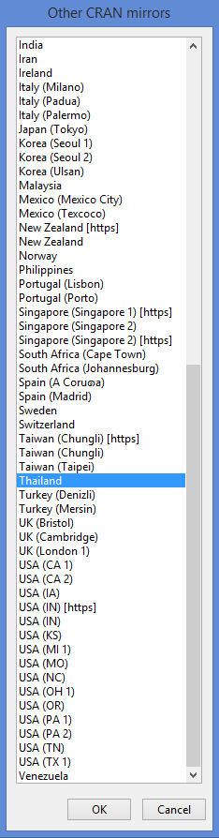
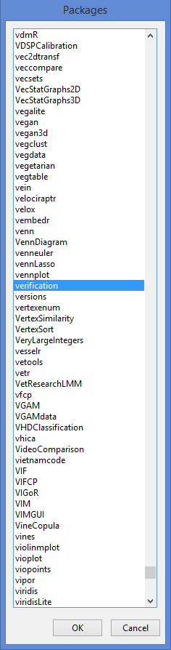
PACK
CONT
VERIFY
SUM
Verification (1)
Install Packages > other mirrors > Thailand > verification

Slide 4
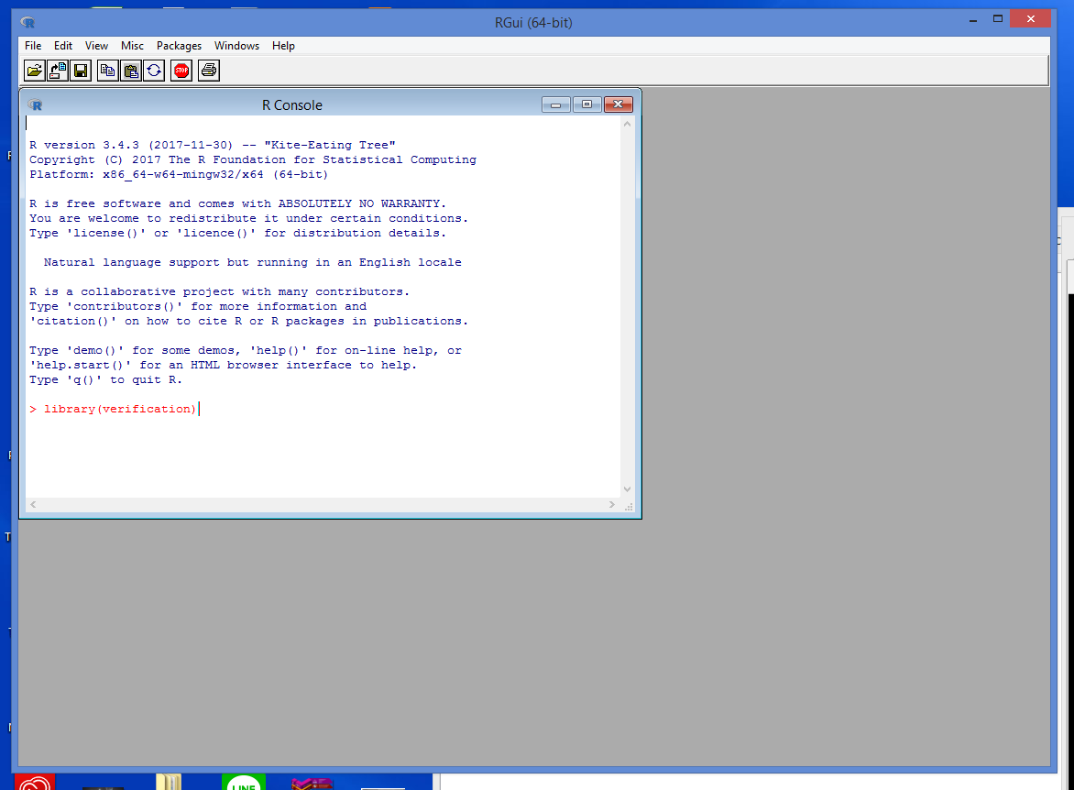
PACK
CONT
VERIFY
SUM
Verification (2)
เรียก library ที่มีอยู่ในโปรแกรม R โดยใช้คำสั่ง
> Library(verification)

Slide 5
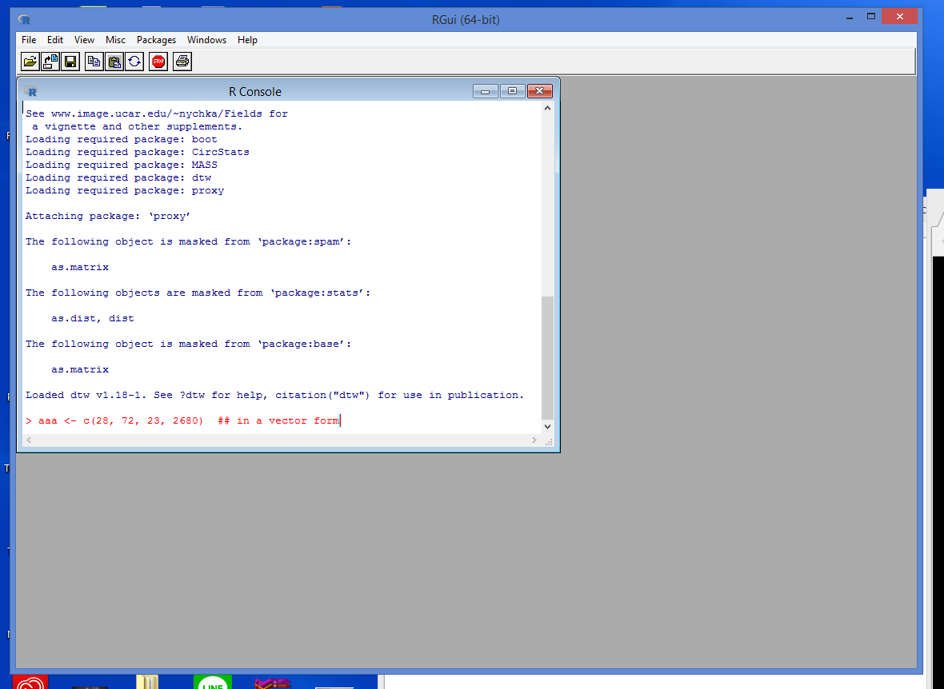
PACK
CONT
VERIFY
SUM
Verification (3)
> aaa <- c(28, 72, 23, 2680)
aaa : ชื่อชุดคำสั่งที่ตั้งขึ้นเอง
c(n11,n10,n01,n00) : contingency table can be entered as a vector containing c(n11, n10, n01, n00)
อ้างอิงจาก https://cran.r-project.org/web/packages/verification/verification.pdf

Slide 6
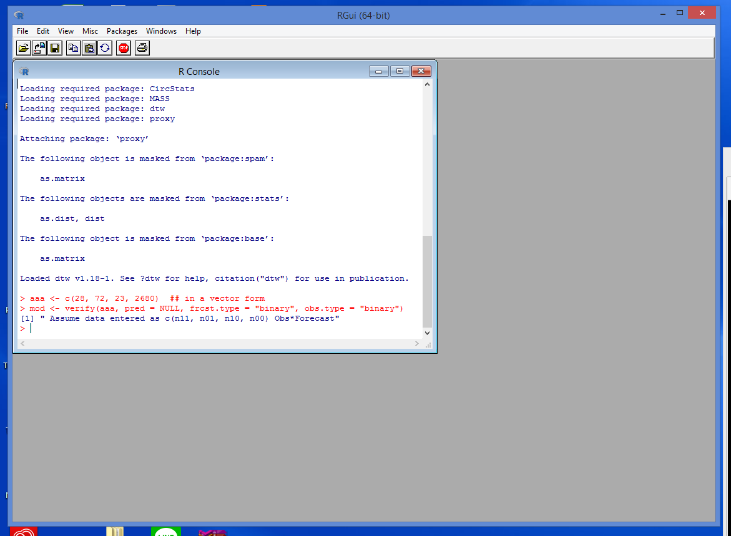
PACK
CONT
VERIFY
SUM
Verification (4)
> mod <- verify(aaa, pred = NULL, frcst.type = “binary”, obs.type = binary”)
mod : ชื่อชุดคำสั่งที่ตั้งขึ้น
verify : the verify function to summarize such forecasts
pred : Prediction of event. The prediction may be in the form of the a point prediction or the probability of a forecast. Let pred = NULL if obs is a contingency table
frcst : Forecast type. One of "prob", "binary", "norm.dist", "cat" or "cont", or "quantile".
obs.type : Observation type. Either "binary", "cat" or "cont". Defaults to "binary"
อ้างอิงจาก https://cran.r-project.org/web/packages/verification/verification.pdf

Slide 7
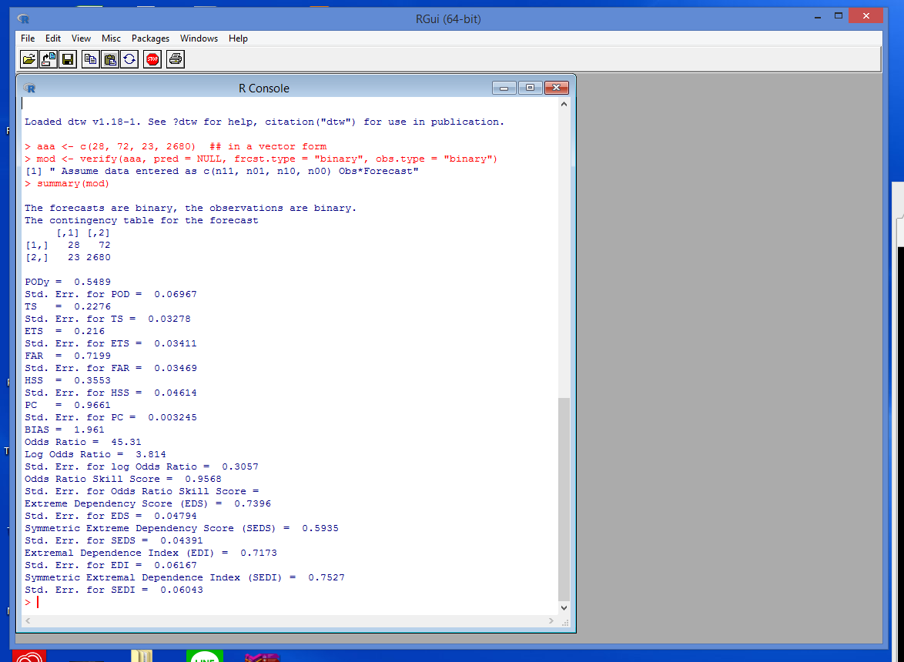
PACK
CONT
VERIFY
SUM
Verification (5)
คำสั่งสรุปข้อมูลที่อยู่ใน mod
> summary(mod)
PODy : Hit Rate (Probability of Detection yes)
Std. Err. : Standard Error
TS : Threat score a.k.a. Critical success index (CSI)
ETS : Equitable Threat Score
FAR : False Alarm RATIO HSS : Heidke Skill Score
PC : Percent correct - events along the diagonal
BIAS : Bias
อ้างอิงจาก https://cran.r-project.org/web/packages/verification/verification.pdf

Slide 8
Thank You
for
Reading

